Slide 1
Web and mobile app development – csc3054/7054
8.3 Smartphone web development

Slide 2
Learning outcomes
Know the concept of mobile web;
Understand why we develop mobile web;
Know the difference between HTML and XHTML;
Understand the development environment set-up;
Know how to use the common syntax to create mobile web pages.

Slide 3
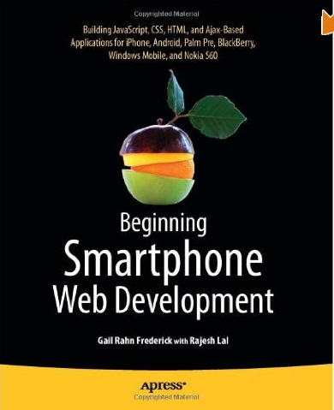
Reference

Slide 4
Content outline
What is “mobile web”?
Why develop “mobile web”?
HTML and XHTML
Development environment set-up
Syntax of mobile web
Summary
Next lecture
Further readings

Slide 5
What is “Mobile web”?
This refers to access to the world wide web from a handheld mobile device, such as a smartphone and a tablet computer.

Slide 6
Content outline
What is “mobile web”?
Why develop “mobile web”?
HTML and XHTML
Development environment set-up
Syntax of mobile web
Summary
Next lecture
Further readings

Slide 7
Why develop “Mobile web”?
http://publishing2.com/2007/09/26/five-reasons-why-the-mobile-web-sucks/
Networks are slow;
WIFI access is a SCAM;
Sites not for small screens;
Device screens are small;
Advertising.

Slide 8
Content outline
What is “mobile web”?
Why develop “mobile web”?
HTML and XHTML
Development environment set-up
Syntax of mobile web
Summary
Next lecture
Further readings

Slide 9
HTML and XHTML
HTML (HyperText Markup Language):
A well-known mobile markup language;
Display data;
May not be appropriate for mobile devices due to resolution, storage, and bandwidth limit.
XHTML (Extensible HTML):
Combines the tag set of HTML with XML (extensible markup language – transport and store data);
Best markup choice for HTML-capable mobile browsers.
A markup language – a system for annotating a document in a way that is syntactically distinguishable from the text.

Slide 10
Content outline
What is “mobile web”?
Why develop “mobile web”?
HTML and XHTML
Development environment set-up
Syntax of mobile web
Summary
Next lecture
Further readings

Slide 11
Development environment set-up
Server-side scripting language, e.g. PHP/JAVA.
Integrated development environment (IDE) with support for scripting and markup language, e.g. Eclipse IDE for Java EE Developers.
Configurable web server, e.g. Apache.
Browser for viewing and testing, e.g. Firefox.

Slide 12
Mime
Multipurpose Internet Mail Extensions (MIME).
A standard that classifies resources and provides information about how to handle them.
Many e-mail clients support MIME to send and receive graphics, audio and video files.

Slide 13
Content outline
What is “mobile web”?
Why develop “mobile web”?
HTML and XHTML
Development environment set-up
Syntax of mobile web
Summary
Next lecture
Further readings

Slide 14
Syntax of mobile web
XHTML: for advanced mobile devices and smartphones.
XHTML-MP (XHTML Mobile Profile ): for mainstream smartphones and mobile devices.
WML (Wireless Markup Language): older mobile devices and browsers that do not support XHTML-MP.

Slide 15
HTML 5
Next major release of the foundational language of the web.

Slide 16
HTML 5
Features (compared to older HTML or XHTML):
New HTML doctype: <!DOCTYPE html>.
New structural markup elements (e.g. <header>, <nav>).
New <audio> and <video> markup elements.
APIs for 2d drawing, media playback, drag/drop and cross-document messaging.

Slide 17
XHTML-MP
XHTML Mobile Profile (XHTML-MP) is a subset of XHTML and developed for mobile devices.
Currently considered as the standard language for Mobile Web development.
It conforms to the strict syntax requirements of XML.
XML – Extensible Markup Language, a markup language that defines rules for encoding doc that is human- and machine-readable.

Slide 18
A simple HTML5 document
<!DOCTYPE html>
<html>
<head>
<title>Title of the document</title>
</head>
<body>
The content of the document......
</body>
</html>

Slide 19
Annotation
DOCTYPE declaration defines the document type.
The text between <html> and </html> describes the web page.
The text between <body> and </body> is visible page content.
The text between <head> and <head> is heading.

Slide 20
Example code
What is the outcome?
<?xml version="1.0" encoding="UTF-8"?>
<!DOCTYPE html PUBLIC "-//WAPFORUM//DTD XHTML Mobile 1.0//EN" "http://www.wapforum.org/DTD/xhtml-mobile10.dtd">
<html xmlns="http://www.w3.org/1999/xhtml">
<head>
<link rel="stylesheet" href="/learnto.css" type="text/css" />
<title>Annotated XHTML Example</title>
</head>
<body>
<div class="hdr">Annotated XHTML Example</div>
</body>
</html>

Slide 21
Explanation to some lines of code
<link rel="stylesheet" href="/learnto.css" type="text/css" />:
This line of code tells our browser that we want to link a Style Sheet, that it’s located in the same folder as our XHTML page, and that it’s named “style.css”.
<div> tag defines a division in an HTML document (with “class” header).
CSS – Cascading Style Service, a style sheet language used to describe the presentation semantics of a document written in a markup language.

Slide 22
More features in xhtml-mp
URI (Uniform Resource Identifier)?
A string of characters used to identify the content, whether it be a page of text, a video or sound clip.
For example: file:///home/username/books/.
For example, Short Message Service (sms): “a” tag uses “href” attribute to specify the link’s destination.
<a href=“sms: +15035551212,+15035551234”>Text us with a question</a>

Slide 23
More features in xhtml-mp
Forms
The <form> element supports action, enctype, and method attributes to specify the URL to submit form data.
Enctype: this attribute specifies how the form-data should be
encoded when submitting it to the server.

Slide 24
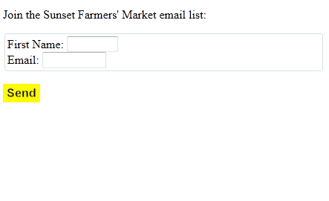
Example

Slide 25
html code – explain please
<?xml version="1.0" encoding="UTF-8"?>
<!DOCTYPE html PUBLIC "-//WAPFORUM//DTD XHTML Mobile 1.0//EN" "http://www.wapforum.org/DTD/xhtml-mobile10.dtd">
<html xmlns="http://www.w3.org/1999/xhtml">
<head>
<link rel="stylesheet" href="/learnto.css" type="text/css" />
<title>XHTML-MP Form</title>
</head>
<body>
<form action="/signup.php" method="post">
<p>Join the Sunset Farmers&apos; Market email list:</p>
<fieldset>
<label>First Name: <input type="text" name="firstname" size="7" title="First"/></label><br/>
<label>Email: <input type="text" name="email" size="10" title="Email"/></label>
</fieldset>
<p>
<input type="image" src="send.jpg" value="Join List" title="Join List"/>
</p>
</form>
</body>
</html>

Slide 26
Homework – associating the table with its HTML code
Tables
<table> element contains <caption> and <tr> child elements.
An HTML table has two kinds of cells:
Header cells - contains header information (created with the <th> element).
Standard cells - contains data (created with the <td> element).

Slide 27
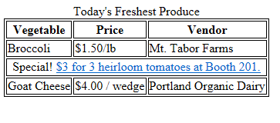
Table

Slide 28
HTML code
<?xml version="1.0" encoding="UTF-8"?>
<!DOCTYPE html PUBLIC "-//WAPFORUM//DTD XHTML Mobile 1.0//EN" "http://www.wapforum.org/DTD/xhtml-mobile10.dtd">
<html xmlns="http://www.w3.org/1999/xhtml">
<head>
<link rel="stylesheet" href="/learnto.css" type="text/css" />
<title>XHTML-MP Table</title>
</head>
<body>
<table class="borderOne">
<caption>Today&apos;s Freshest Produce</caption>
<tr align="center" valign="top">
<th>Vegetable</th>
<th>Price</th>
<th>Vendor</th>

Slide 29
HTML code
</tr>
<tr align="left" valign="top">
<td class="vegName">Broccoli</td>
<td class="vegPrice">$1.50/lb</td>
<td class="vegVendor">Mt. Tabor Farms</td>
</tr>
<tr>
<td align="center" valign="middle" class="special" colspan="3">Special! <a href="/specials.php">$3 for 3 heirloom tomatoes at Booth 201.</a></td>
</tr>
<tr align="left" valign="top">
<td class="vegName">Goat Cheese</td>
<td class="vegPrice">$4.00 / wedge</td>
<td class="vegVendor">Portland Organic Dairy</td>
</tr>
</table>
</body>
</html>

Slide 30
Content outline
What is “mobile web”?
Why develop “mobile web”?
HTML and XHTML
Development environment set-up
Syntax of mobile web
Summary
Next lecture
Further readings

Slide 31
Summary
Introduced the concept of “mobile web”.
Explained why we develop “mobile web”.
Explained the difference between HTML and XHTML.
Slightly mentioned the development environment set-up.
Showed examples for using syntax of mobile web.

Slide 32
Content outline
What is “mobile web”?
Why develop “mobile web”?
HTML and XHTML
Development environment set-up
Syntax of mobile web
Summary
Next lecture
Further readings

Slide 33
next lecture
To continue with the introduction of features in XHTML-MP and others.

Slide 34
Content outline
What is “mobile web”?
Why develop “mobile web”?
HTML and XHTML
Development environment set-up
Syntax of mobile web
Summary
Next lecture
Further readings

Slide 35
Further readings
Beginning Smartphone Web Development: Building JavaScript, CSS, HTML and Ajax-based Applications for iPhone, Android, Palm Pre, BlackBerry, Windows Mobile and Nokia S60. Gail Frederick. Publisher: Apress; 1 edition (January 15, 2010).

